Slide 1


Slide 2
Two algorithms are currently available in latools:
* K-Means will divide the data up into N groups of equal variance, where N is a known number of groups.
* Mean Shift will divide the data up into an arbitrary number of clusters, based on the characteristics of the data.

Slide 3
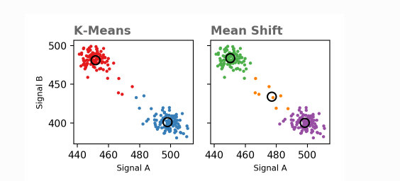

Slide 4
